Slide 1
Information Visualization Session 4: Tell Your Story

Slide 2
Speaker
Lauren Luxenburg
@LaurenC_Lux
Director at WPA Research
lluxenburg@wparesearch.com

Slide 3
Agenda
Interactive visualizations
Choosing a visual for promotion
Sharing best practice
Defending your visualization

Slide 4
visualization design

Slide 5
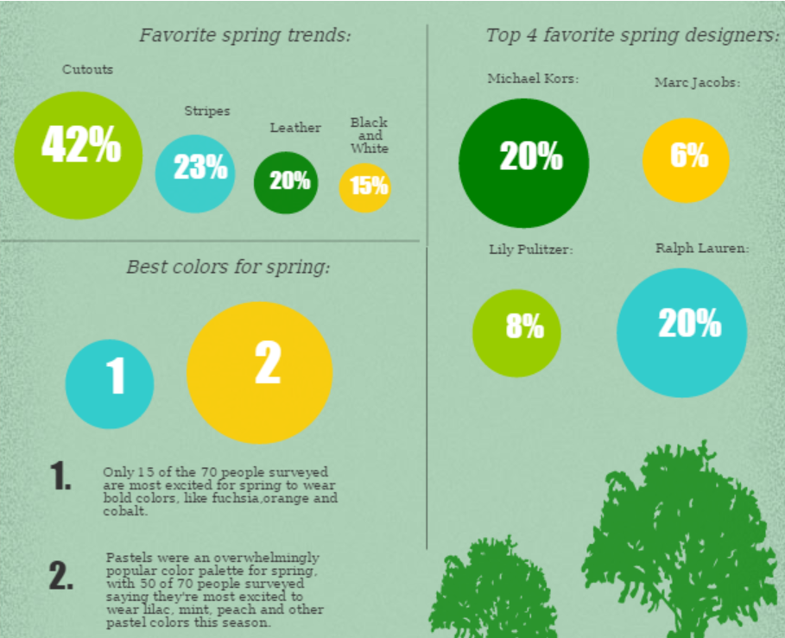

Color Design
Complement
Contrast

Slide 6
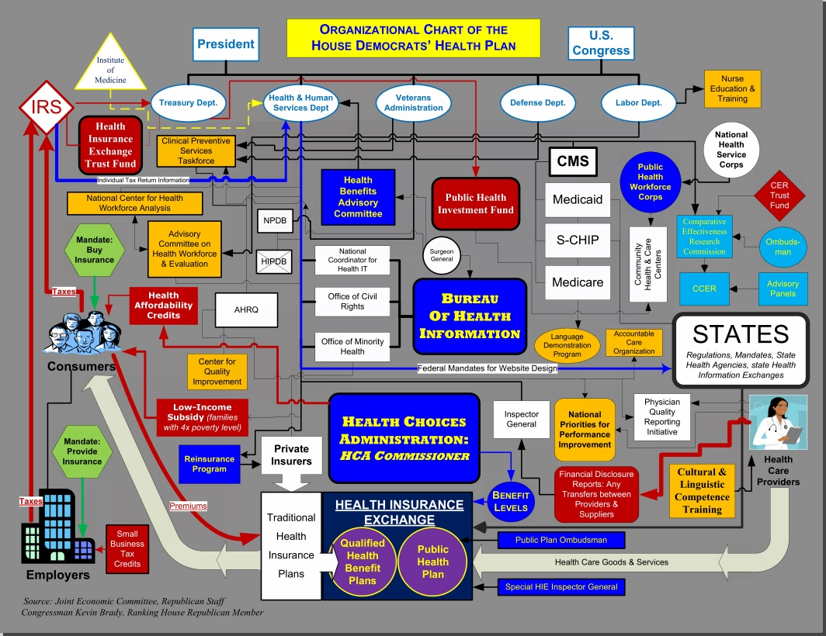
Color Design
Intentionally awful

Slide 7
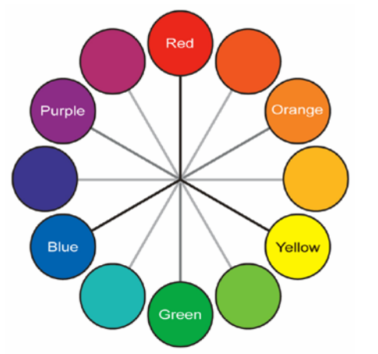
Color Design
Using a hue wheel

Slide 8
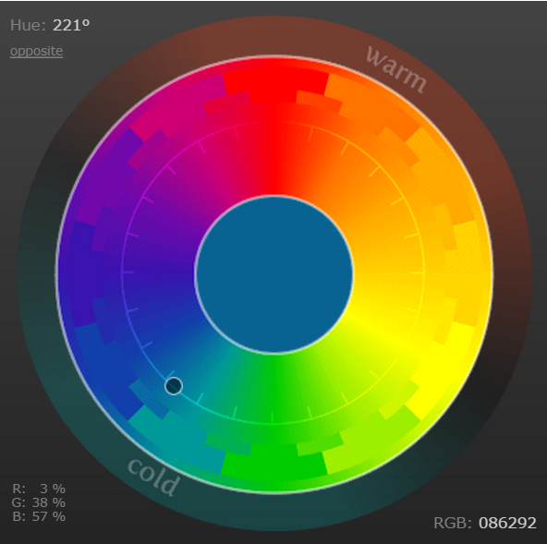
Color Design
Online color tools
http://colorschemedesigner.com/csd-3.5/

Slide 9
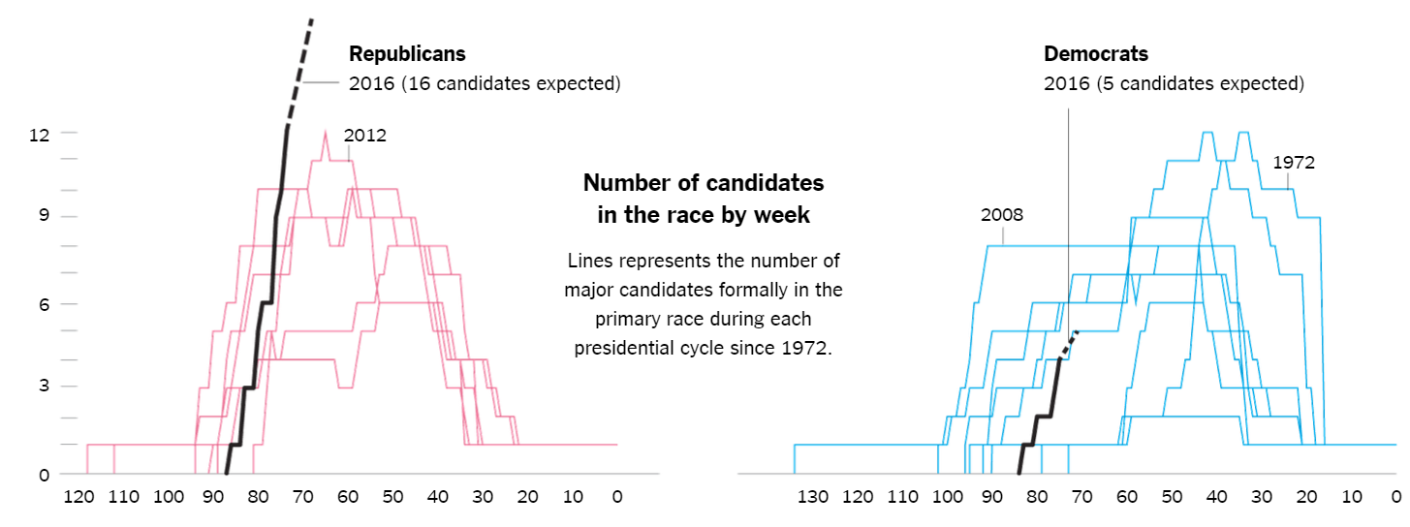
Text
Minimize textual information

Slide 10
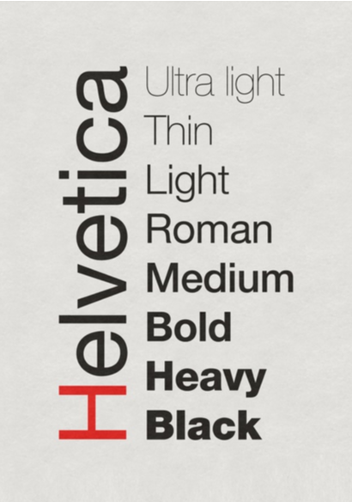
Text - fonts
Keep to one font family
Helvetica (on Mac)
Segoe (on Windows)
Handwriting fonts
http://www.yourfonts.com/

Slide 11
Text - fonts
Identify Fonts
http://myfonts.com/whatthefont
Handwriting fonts
http://www.yourfonts.com/

Slide 12
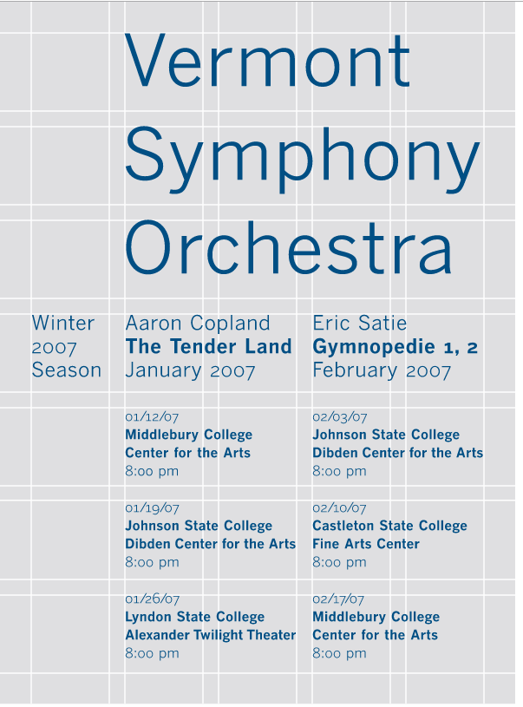
layout
Alignment
grid systems (swiss)

Slide 13
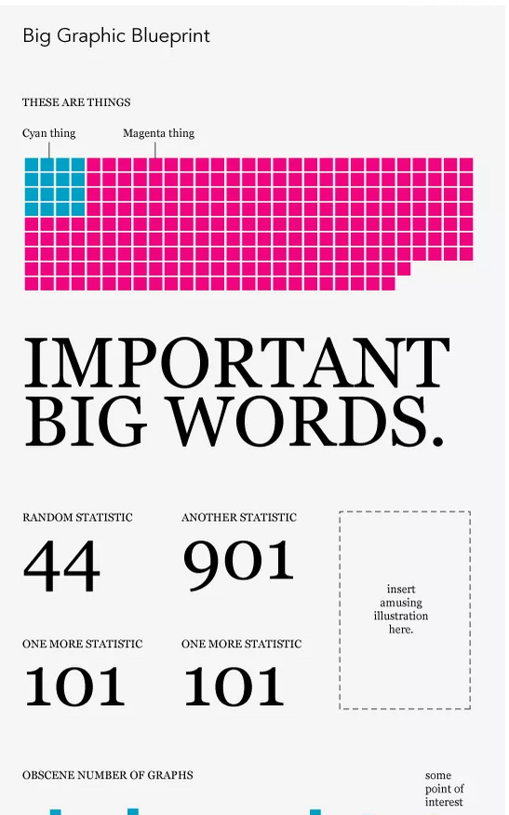
layout
Alignment
grid systems (swiss)
Templates
the big data graphic blueprint
http://flowingdata.com/2010/02/15/data-underload-9-big-graphic-blueprint/

Slide 14
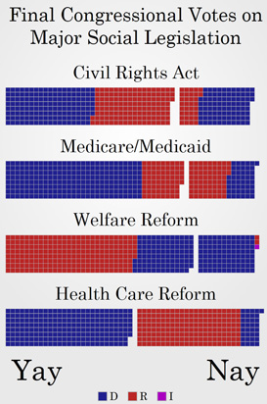
layout
unit segmentation
visual detail lends visual interest to the scene
http://politicalmathblog.com/?p=424

Slide 15
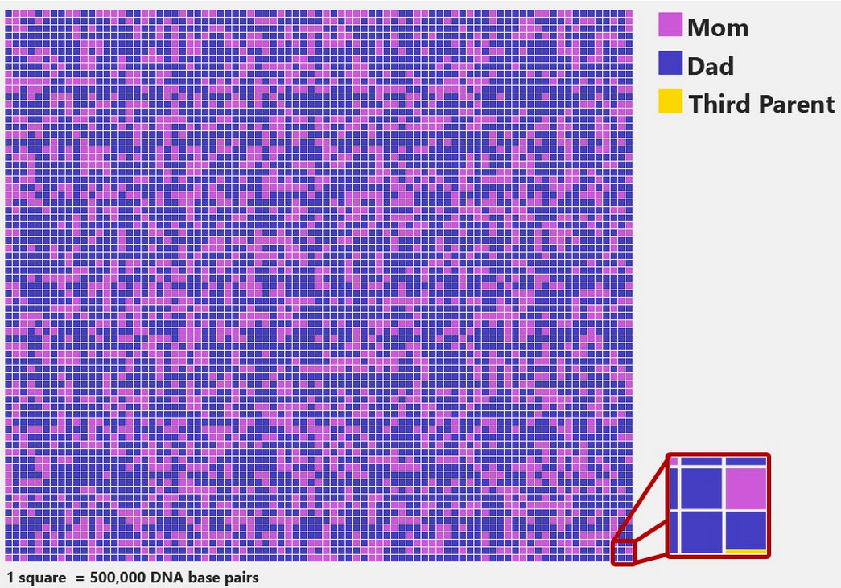
Start at the end
What is the key data point?
How can we display it to make an impact?
Put it at the end
https://medium.com/@politicalmath/what-does-a-3-parent-baby-look-like-706e9e5f45e9

Slide 16
interactive visualizations

Slide 17
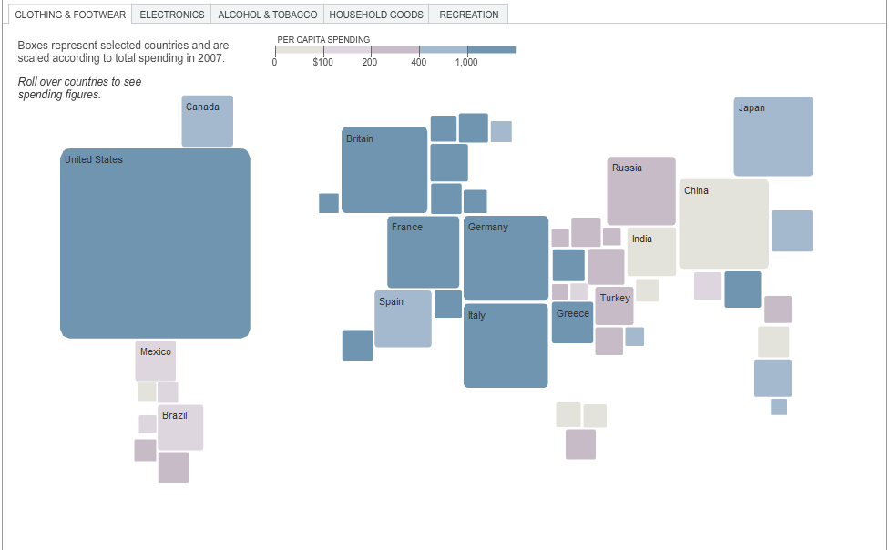
Layering Data With Interaction
http://www.nytimes.com/interactive/2008/09/04/business/20080907-metrics-graphic.html

Slide 18
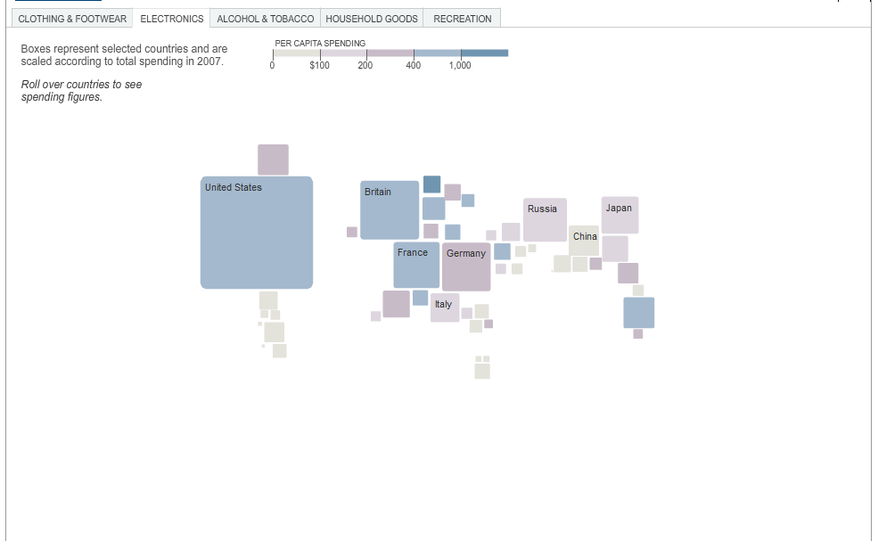
Layering Data With Interaction
http://www.nytimes.com/interactive/2008/09/04/business/20080907-metrics-graphic.html

Slide 19
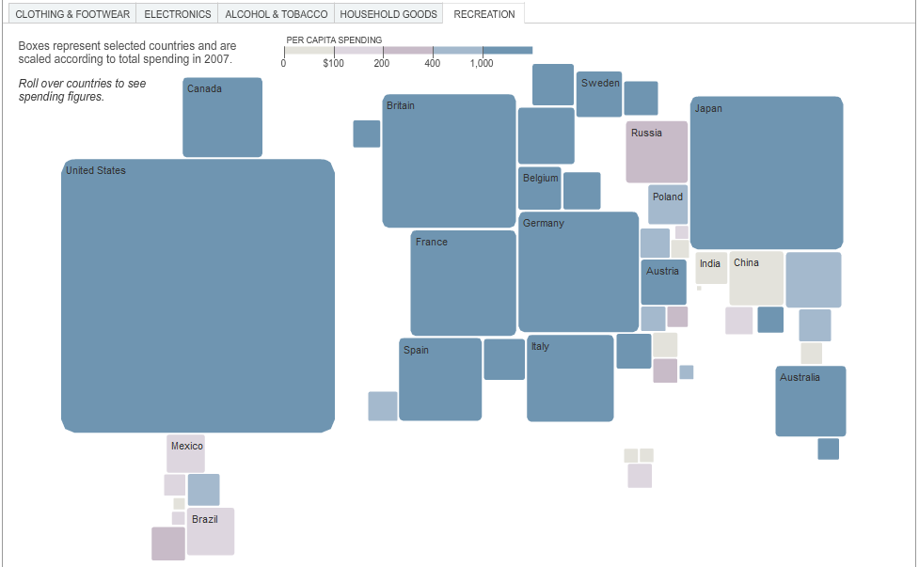
Layering Data With Interaction
http://www.nytimes.com/interactive/2008/09/04/business/20080907-metrics-graphic.html

Slide 20
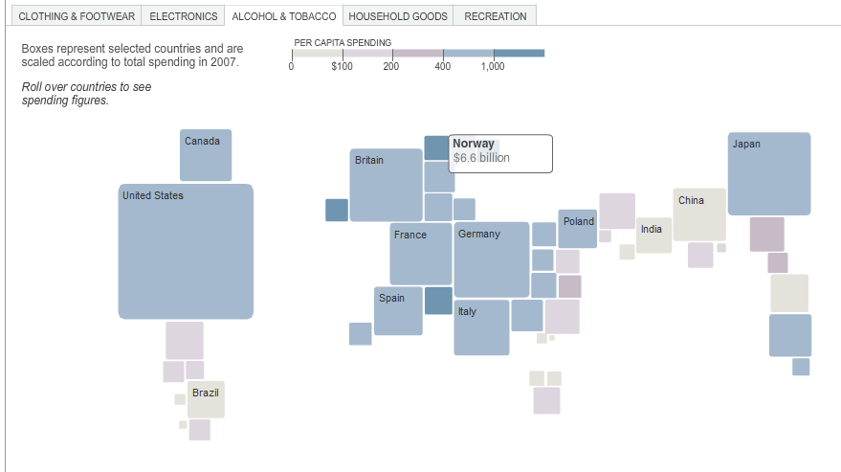
Layering Data With Interaction
http://www.nytimes.com/interactive/2008/09/04/business/20080907-metrics-graphic.html

Slide 21
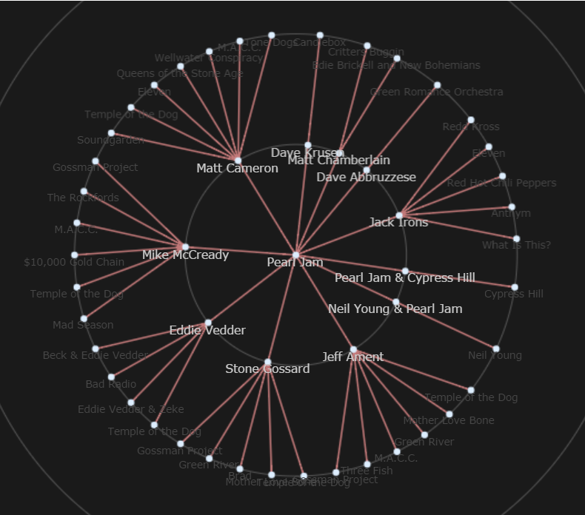
Features of Interactive Visualizations
Web accessible
Rarely mobile-friendly
Programmatic
ProcessingJS
d3.js
Javascript InfoVis Toolkit
http://philogb.github.io/jit/

Slide 22
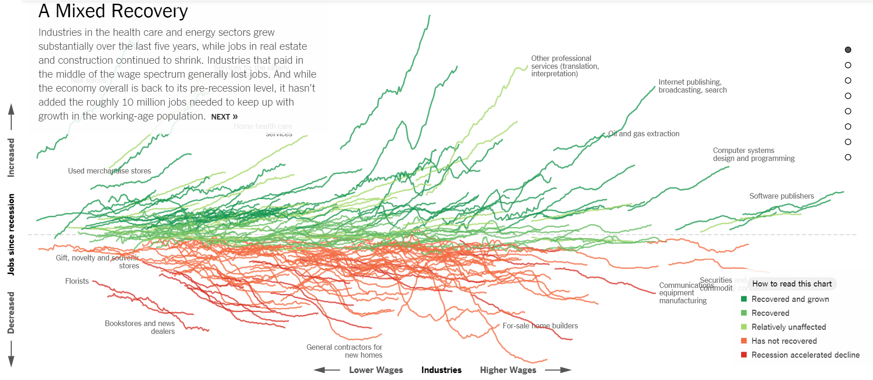
Adding Interaction To A Visualization
Tabs
Sliders
Mouse Hover
Mouse Click
http://www.nytimes.com/interactive/2014/06/05/upshot/how-the-recession-reshaped-the-economy-in-255-charts.html

Slide 23
Pros of Interactive Visualizations
Wicked Cool
Exploration of Large Data Sets
High Visibility, High Engagement

Slide 24
Cons of Interactive Visualizations
Difficult to share
Not usually touch friendly
Not search engine friendly
Time consuming

Slide 25
Interactive Visualization Team
Design
Communication
Technical

Slide 26
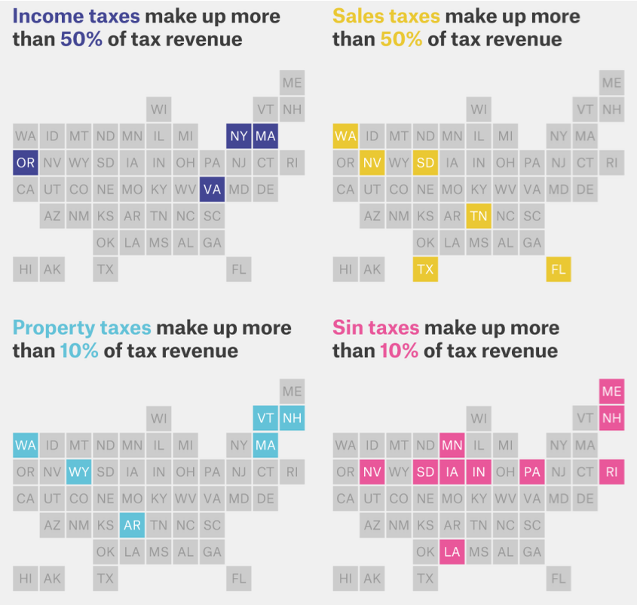
Alternative to Interactive Visualizations
Multiple Static Visualizations
http://fivethirtyeight.com/features/where-your-state-gets-its-money/

Slide 27
choosing a visual for promotion

Slide 28
Sharing through social media
Facebook, Twitter previews = 9x5 ratio
Instagram = 1 x 1

Slide 29
defending your visualization

Slide 30
Defending – Show Your Work
Make Excel files available for download
Import files to Google Docs

Slide 31
Defending – Ready To Be Wrong

Slide 32
Where to go from here?

Slide 33
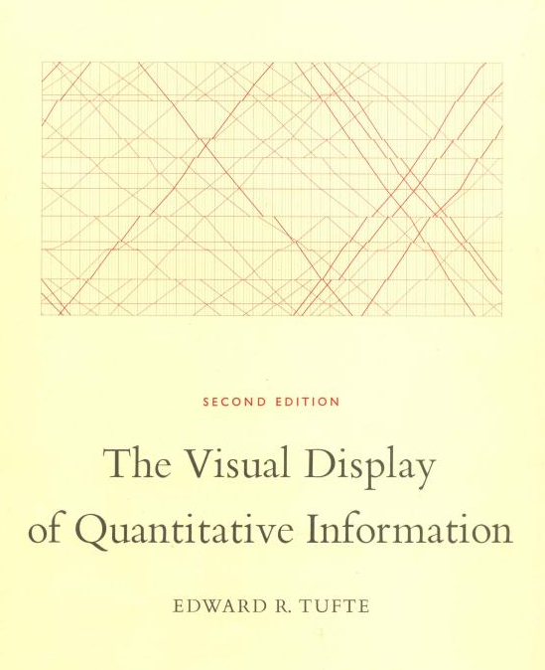
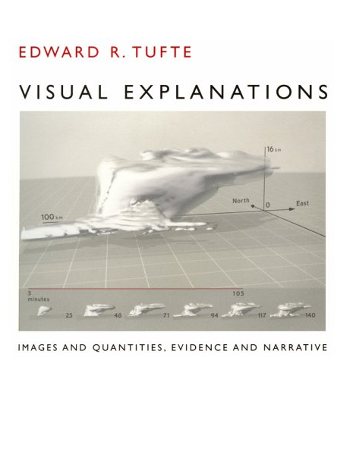
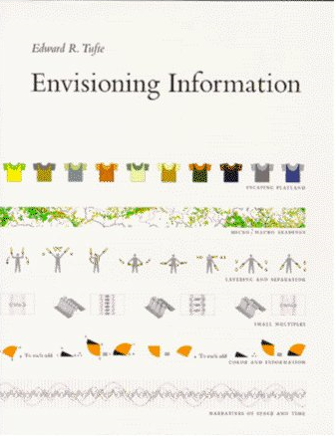
Edward Tufte
visualization book club
Information Visualization god
Notes:
Finally, if you’d like to know more about visualization, here are a couple of recommendations. First in line is Edward Tufte. Tufte is considered the leader in information visualization literature. If you’re more interested in discussion over hundreds of examples and a more academic approach to the topic, this is the way to go.

Slide 34
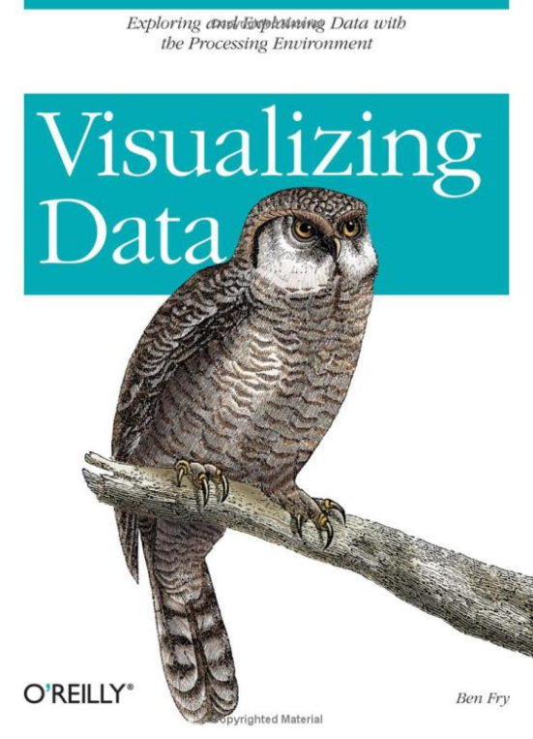
Ben Fry
visualization book club
“Visualizing Data”
Processing
http://processing.org
http://benfry.com/
Notes:
If you’re looking for something a little bit more hands-on and you don’t mind doing some programing, Ben Fry wrote a book called “Visualizing Data” in which he walks through several code-complete visualizations using a number of different data sets and techniques.

Slide 35
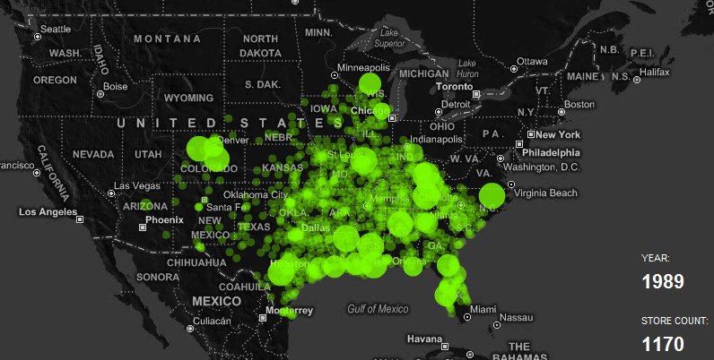
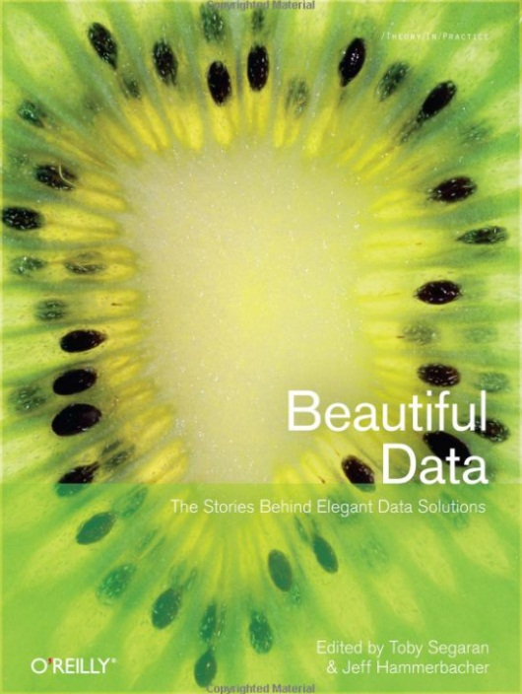
Nathan Yau
visualization book club
Contributing Author for Beautiful Data
http://flowingdata.com/
Notes:
Finally, if you just have a passing interest in data visualization, but you want to see more cool stuff, check out Nathan Yau’s blog “Flowing Data”. Yau is a PhD student (soon to be a PhD) who is deep into information visualization and posts visualizations that pop up on the web. It’s an excellent blend of good examples, bad examples and academic offerings.

Slide 36
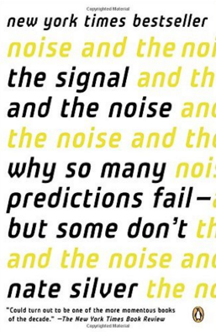
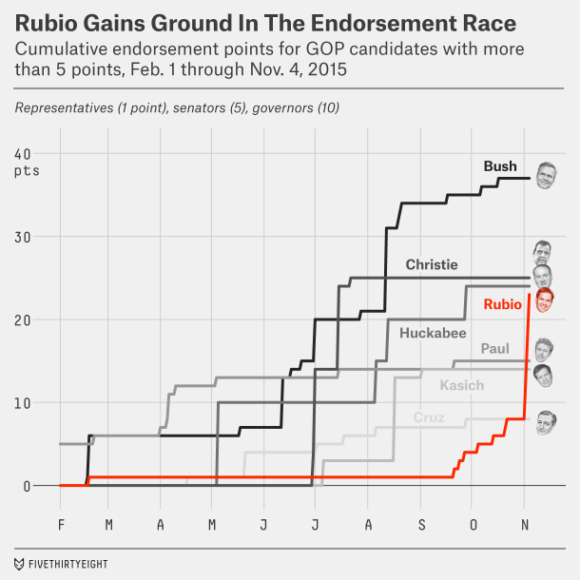
Nate Silver
visualization book club
http://fivethirtyeight.com/
Notes:
Finally, if you just have a passing interest in data visualization, but you want to see more cool stuff, check out Nathan Yau’s blog “Flowing Data”. Yau is a PhD student (soon to be a PhD) who is deep into information visualization and posts visualizations that pop up on the web. It’s an excellent blend of good examples, bad examples and academic offerings.

Slide 37
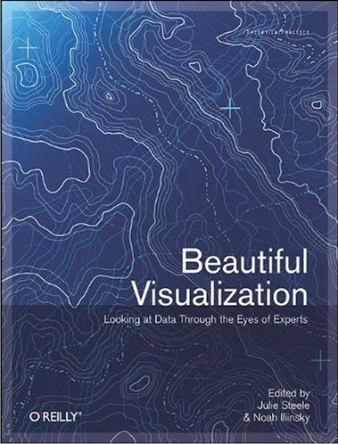
Beautiful Visualization
visualization book club
Free Chapter
“Once Upon a Stacked Time Series”
Notes:
Finally, The O’Reilly book “Beautiful Visualization” is a compilation of visualization topics and techniques from over a dozen leaders in the field.

